Slide 1



Comprehensive Audit and Analysis for Effective Digital Presence Summary
Presentation by:
Thambidurai Sundaramoorthy

Slide 2

TABLE OF CONTENT
Project Objectives
Company and it’s description
Website Audit Report
Performance Analysis
Responsiveness
SEO Metric Analysis
Content Audit
Digital Marketing Strategy
Overall Recommendations
Site Landing Page creation

Slide 3
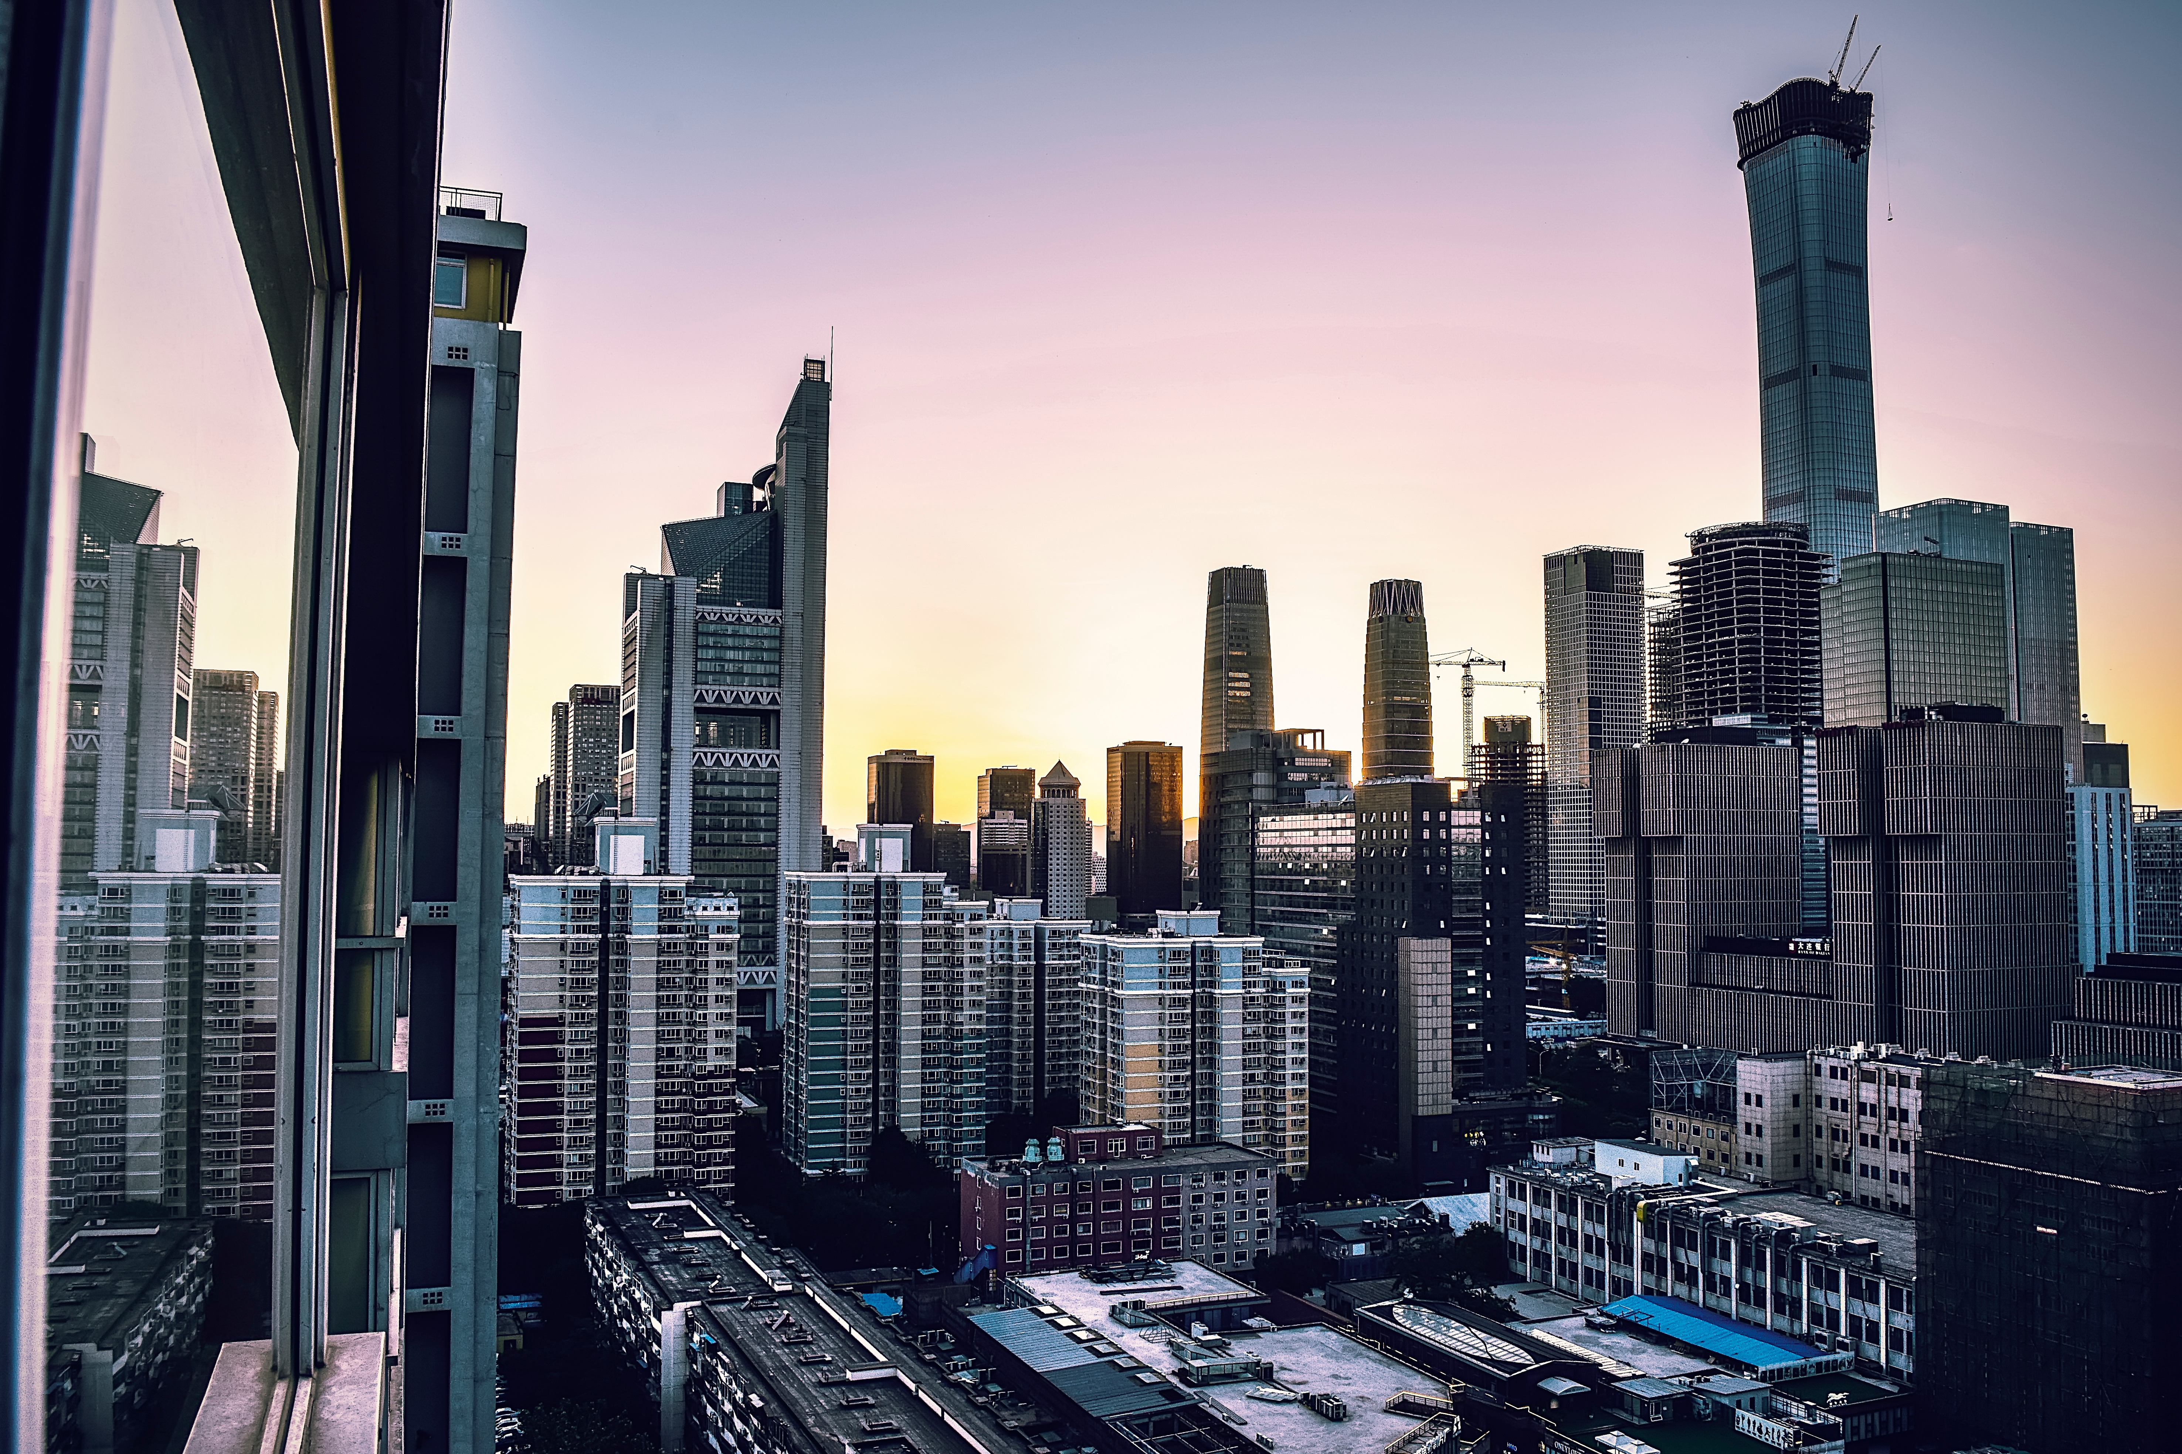
Project Objectives
To understand Digital Marketing Fundamentals: To learn the key principles of digital marketing, focusing on website or landing page design.
To apply the concepts of web design and digital marketing fundamentals to audit and analyze existing websites, identify areas of improvement, and design a basic website or landing page using WordPress.

Slide 4
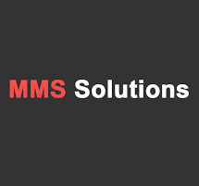
Company
📱 MMS Solutions – Expert Smartphone Repair & Service
MMS Solutions is a trusted smartphone repair and service centre with 6 outlets across Chennai, serving customers for over 10 years. We specialize in LG, OnePlus, Pixel, iQOO, and Nothing smartphones, offering fast, reliable, and affordable solutions. Our expert technicians handle screen replacements, battery fixes, software troubleshooting, and more, using genuine parts to ensure top-quality repairs.
With a decade of experience, we are committed to quick service, expert repairs, and customer satisfaction, keeping your devices running at their best.
📍 6 Convenient Locations | 🔧 10+ Years of Expertise | ✅ Genuine Parts
📧 For Support: support@mmsservice.in 🌐 For More Information: www.mmsservice.in

Slide 5
Website Audit Report
Audited Web Pages
Home – https://www.mmsservice.in/
Brands/LG Smartphones – https://www.mmsservice.in/lg-smartphone.php
Services/LG Service Center - https://www.mmsservice.in/lg-mobile-service-center.php
Tools Used
PageSpeed Insights – https://pagespeed.web.dev/
Responsive Website Design Tester – https://responsivedesignchecker.com/
Hemingway Editor - https://hemingwayapp.com/
Pro Free Host - https://profreehost.com/
Wordpress within Pro Free Host and Google Search Console

Slide 6
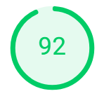
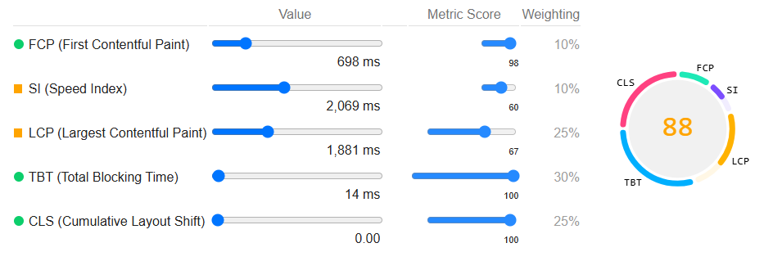
Home Web Page
Performance Analysis for Desktop

Slide 7
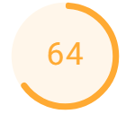
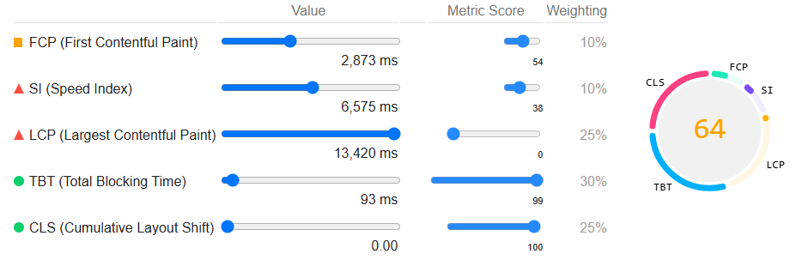
Home Web Page
Performance Analysis for Mobile

Slide 8
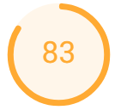
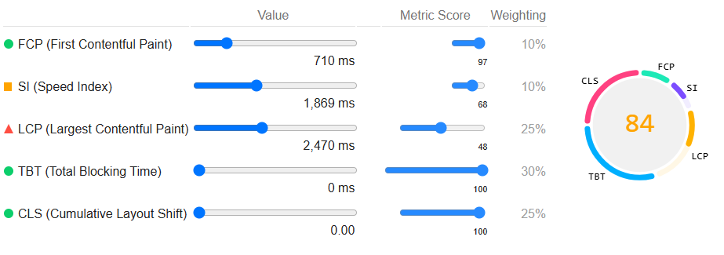
Brands/LG Smartphones
Performance Analysis for Desktop

Slide 9
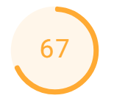
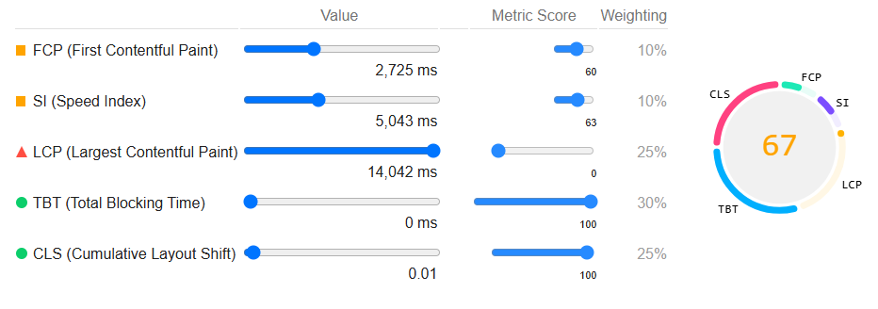
Brands/LG Smartphones
Performance Analysis for Mobile

Slide 10
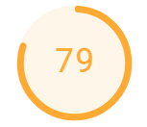
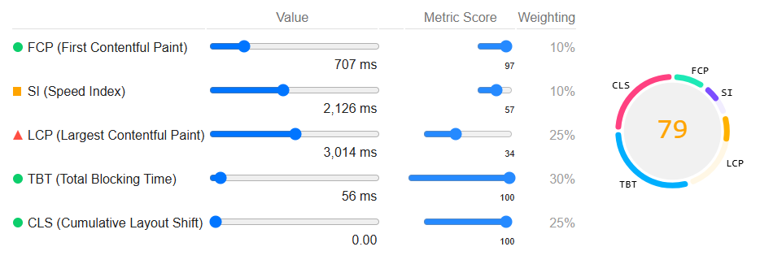
Services/LG Service Center
Performance Analysis for Desktop

Slide 11
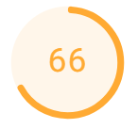
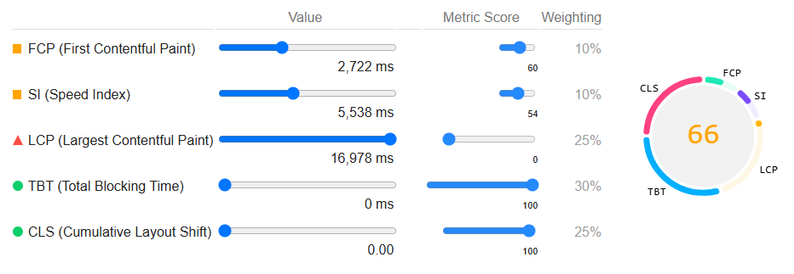
Services/LG Service Center
Performance Analysis for Mobile

Slide 12
Performance Analysis
This performance has been measured through the metrics First Contentful Paint (FCP), Speed Index (SI), Large Contentful Paint (LCP), Total Blocking Time (TBT), Cumulative Layout Shift (CLS).
TBT and CLS values are within the range for all the web pages in the website.
SI and LCP values exceeds it’s range in all the web pages.
FCP values are within the range for desktop versions where as outside the range for mobile versions in all the web pages.
This has been performed using the PageSpeed Insights tool.
Metrics | Value Ranges
First Contentful Paint (FCP) | O to 950 ms
Speed Index (SI) | O to 1300 ms
Large Contentful Paint (LCP) | O to 1200 ms
Total Blocking Time (TBT) | O to 150 ms
Cumulative Layout Shift (CLS) | O to 0.10
Overall Metric Score Range

Slide 13
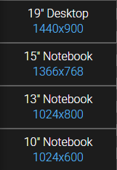
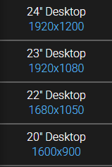
Responsiveness
Responsiveness for Desktop

Slide 14
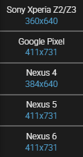
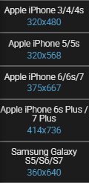
Responsiveness
Responsiveness for Mobile

Slide 15
Responsiveness Analysis
Responsive design is a website layout that responds (scales itself) automatically to an array of devices (screen sizes) and resolutions. Basically, the websites should be mobile friendly.
All the web pages in the website is accessible in a desktop and mobile as well without losing quality.
The resolution of the website changes itself depending on the device screen size.
This site is mobile friendly.
This has been performed using the tool Responsive Website Design Tester.

Slide 16
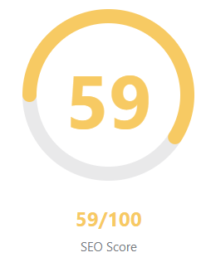
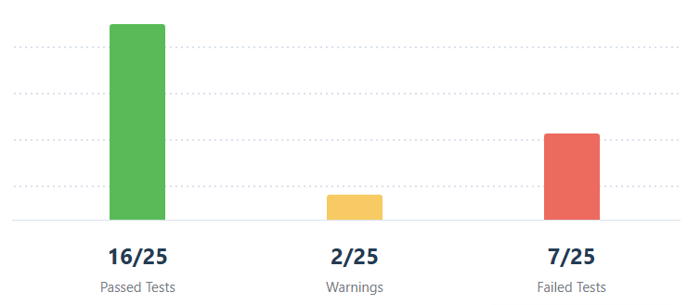
SEO Metric Analysis
Home Web Page

Slide 17



Basic SEO Analysis for Home Web Page
Metrics | Tests | Explanations
Keywords |  | Smartphones, repair, Chennai, service, center, solutions, phone, parts, smartphone, repairs.
SEO Description |  | Meta description found with 141 characters. Most Trusted Mobile Service Center in Chennai. Specialists in Oneplus Phones, Apple Iphone, Motorola, Samsung Mobile, & Google Pixel services.
H1 Heading |  | Too many H1 tags found on your homepage (13). For the best SEO results there should be exactly one H1 tag on each page.
H2 Headings |  | One or more H2 tags were found on your homepage. OUR Branches, Adyar Chennai, Alwarpet Chennai, Ramapuram Chennai, Egmore Chennai.
Image ALT Attributes |  | Some images on homepage have no alt attribute. (6) – To check the images for missing alt tags, and to add useful descriptions to each image. To add the keywords or synonyms in a natural way.
Keywords in Title & Description |  | One or more common keywords were found in the title and description of your homepage. Title – Chennai, service, center, solutions Description – Chennai, service, center, phone
Links Ratio |  | Homepage has a correct number of internal and external links. 15 internal and 0 external links.
SEO Title |  | The title of the homepage has 46 characters which is good. MMS Solutions Mobile Service Center In Chennai

Slide 18
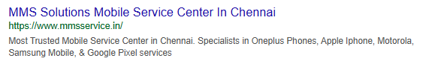
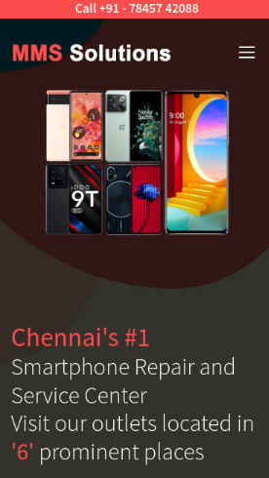
Advanced SEO Analysis for Home Web Page
Metrics | Tests | Explanations
Search Preview
Mobile Snapshot

Slide 19
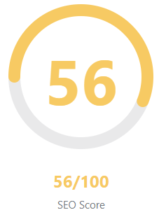
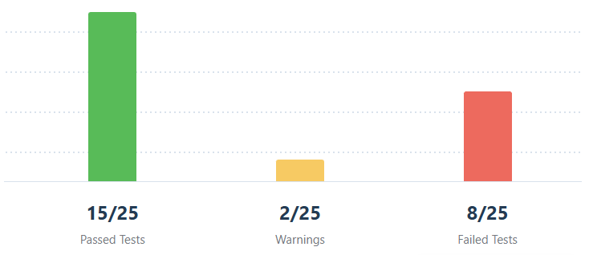
SEO Metric Analysis
Brands/LG Smartphones

Slide 20
Basic SEO Analysis for Brands/LG Smartphones
Metrics | Tests | Explanations
Keywords |  | Chennai, service, center, device, repair, road, mobile, supportmmsservice.in, smartphones, Nungambakkam.
SEO Description |  | Meta description found with 35 characters. LG Mobile Service Center in Chennai.
H1 Heading |  | Too many H1 tags found on your homepage (4). For the best SEO results there should be exactly one H1 tag on each page.
H2 Headings |  | One or more H2 tags were found on your homepage. OUR Branches, Adyar Chennai, Alwarpet Chennai, Ramapuram Chennai, Egmore Chennai.
Image ALT Attributes |  | Some images on homepage have no alt attribute. (2) – To check the images for missing alt tags, and to add useful descriptions to each image. To add the keywords or synonyms in a natural way.
Keywords in Title & Description |  | One or more common keywords were found in the title and description of your homepage. Title – Chennai, service, center, mobile Description – Chennai, service, center, mobile
Links Ratio |  | Homepage has a correct number of internal and external links. 15 internal and 1 external links.
SEO Title |  | The title of the homepage has 84 characters. Most search engines will truncate meta titles to 75 characters. LG Mobile Service Center in Chennai | LG Mobile Authorized Service Center in Chennai

Slide 21
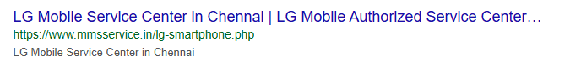
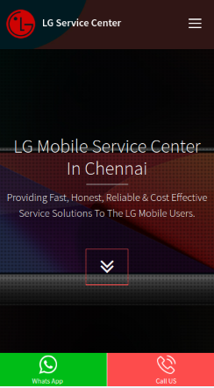
Advanced SEO Analysis for Brands/LG Smartphones
Metrics | Tests | Explanations
Search Preview
Mobile Snapshot

Slide 22
SEO Metric Analysis
Services/LG Service Center

Slide 23
Basic SEO Analysis for Services/LG Service Center
Metrics | Tests | Explanations
Keywords |  | Chennai, service, center, device, repair, road, mobile, supportmmsservice.in, smartphones, Nungambakkam.
SEO Description |  | Meta description found with 93 characters. LG Mobile Service Center | LG Smartphone Service Center | LG Mobile Authorized Service Center
H1 Heading |  | Too many H1 tags found on your homepage (4). For the best SEO results there should be exactly one H1 tag on each page.
H2 Headings |  | One or more H2 tags were found on your homepage. OUR Branches, Adyar Chennai, Alwarpet Chennai, Ramapuram Chennai, Egmore Chennai.
Image ALT Attributes |  | Some images on homepage have no alt attribute. (2) – To check the images for missing alt tags, and to add useful descriptions to each image. To add the keywords or synonyms in a natural way.
Keywords in Title & Description |  | One or more common keywords were found in the title and description of your homepage. Title – service, center, mobile Description – service, center, mobile
Links Ratio |  | Homepage has a correct number of internal and external links. 15 internal and 1 external links.
SEO Title |  | The title of the homepage has 93 characters. Most search engines will truncate meta titles to 75 characters. LG Mobile Service Center | LG Smartphone Service Center | LG Mobile Authorized Service Center

Slide 24
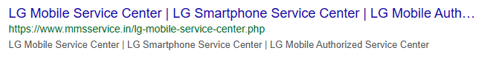
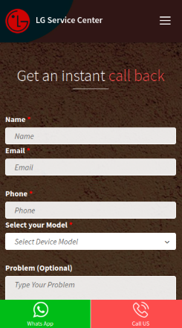
Advanced SEO Analysis for Services/LG Service Center
Metrics | Tests | Explanations
Search Preview
Mobile Snapshot

Slide 25

Common SEO Analysis for all web pages
Metrics | Tests | Explanations
Create a responsive site |  | CSS code contains media queries.
Homepage Is Reachable |  | Homepage is reachable.
Canonical Tag |  | No canonical tag found.
Noindex Meta |  | Homepage does not contain any index meta tag or header.
WWW Canonicalization |  | Both www and non-www versions of your URL are redirected to the same site.
OpenGraph Meta |  | Some Opengraph meta tags are missing.
Robots.txt |  | Robots.txt file is missing or unavailable.
Schema Meta Data |  | No Schema.org data found on your homepage.
Keep your content fresh |  | No content freshness information found (no XML sitemap lastmod, og:updated_time, or Last-Modified header).
Sitemaps |  | No sitemaps found.

Slide 26
Common SEO Analysis for all web pages
Metrics | Tests | Explanations
Image Headers Expire |  | No local images found.
Minify CSS |  | All CSS files appear to be minified.
Minify Javascript |  | All Javascript files appear to be minified.
Response Time |  | Response time is under 0.2 seconds which is great.
Directory Listing |  | Directory Listing seems to be disabled on your server.
Secure Connection |  | Site is using a secure transfer protocol (https).
Metrics | Tests | Home Web Page | Brands/LG Smartphones | Services/LG Service Center
Page Objects |  | Homepage makes 24 requests including 7 images, 4 Javascripts, 13 stylesheets. This result in slow page loading. | Homepage makes 26 requests including 10 images, 3 Javascripts, 13 stylesheets. This result in slow page loading. | Homepage makes 26 requests including 10 images, 3 Javascripts, 13 stylesheets. This result in slow page loading.
Page Size |  | The size of the HTML document is 9 Kb, under the average HTML size of 33 Kb. | The size of the HTML document is 8 Kb, under the average HTML size of 33 Kb. | The size of the HTML document is 9 Kb, under the average HTML size of 33 Kb.

Slide 27
Content Audit
A Content Audit Report evaluates the quality, relevance, and engagement of a website’s content. It analyzes factors such as clarity, consistency, SEO effectiveness, and user experience. The report highlights strengths, identifies areas for improvement, and provides actionable recommendations to enhance the website’s impact and visibility.
Content Quality
Content Relevance
Content Engagement

Slide 28
Content Quality
Metrics | Home Web Page | Brands/LG Smartphones | Services/LG Service Center
Total Words | 538 words | 334 words | 336 words
Readability Grade | 6 | 4 | 4
Readability Status | Good | Good | Good
Very hard to read | 5 out of 61 sentences | 1 out of 70 sentences | 1 out of 72 sentences
Hard to read | 7 out of 61 sentences | 0 out of 70 sentences | 0 out of 72 sentences
Weakeners (adverbs, passive voice and qualifiers) | 8 words | 1 word | 1 word
Simpler alternative | 1 word | 0 words | 0 words

Slide 29
Content Relevance
Target Audience:
Smartphone users needing repair services in Chennai.
The content addresses specific needs and concerns.
Topic Coverage:
The website covers essential topics related to smartphone repairs, supported brands, warranty policies and service centre contact information.
Pricing info for the service is missing in the website which is one of the essential information.
Content Freshness:
The contents that are mentioned with in the website are up to date.
Keywork Relevance:
Some of the keywords mentioned in the meta description are not relevant as Apple, Motorola and Samsung mobiles are mentioned which is not being supported.

Slide 30
Content Engagement
Content Readability:
Implement blog posts, case studies to increase time spent.
Optimize content with clear messaging to retain visitor attention.
Calls-to-Action (CTAs):
CTAs are available in Brands, Services and Contact options on the website with lead-generation method by filling the form.
Social Engagement:
There are limited social sharing options on the website and no social media accounts linked.
No visible user-generated content, reviews, or engagement tools.

Slide 31
Digital Marketing Strategy
Goals:
Increase brand awareness and online visibility.
Improve website traffic & SEO ranking.
Generate leads & conversion for repair services.
Enhance customer engagement through social media and online reviews.
Align traditional marketing efforts (offline promotions) with digital strategies.
Traditional vs Digital Marketing Alignment
Traditional Marketing | Digital Marketing
Flyers, banners, in-store promotions | QR codes leading to service pages
TV/Radio ads | YouTube & Instagram ads targeting the same audience
Customer referral programs | Online referral tracking and incentives
Newspaper ads | Blog articles and SEO to target same search intent

Slide 32
Digital Marketing Strategy
Recommendations to improve Digital Marketing Strategy:
SEO Improvements:
Implement local SEO with Google My Business (GMB) optimization.
Optimize meta titles, descriptions and keywords for repair-related services.
Add an FAQ section to target long-tail keywords.
UX Enhancements:
Make the service request form more prominent.
Improve navigation to include pricing and repair timeline.
Implement live chat support for quick customer queries.
Content Marketing Strategy:
Publish articles on smartphone troubleshooting, repair tips and brand comparison and include How-to guides.
Create short repair demonstration video for the social media accounts and share customer testimonials videos.
Post before/after repair images, customer stories and offers.

Slide 33
Digital Marketing Strategy
Recommendations to improve Digital Marketing Strategy:
Paid advertising:
Run search ads for high-intent keywords through Google Ads.
Target audiences looking for repair-related content through YouTube Ads.
Local Marketing & Reputation Management:
Optimize GMB for better visibility in local searches and run geo-targeted ads focusing customers in Chennai.
Encourage customers to leave Google & Facebook reviews.
Respond to customer inquiries and complaints on all platforms.
Performance Tracking & Analytics:
Use Google analytics to track website traffic & conversions.
Monitor SEO rankings using tools like Ahrefs or SEMrush.
Measure social media engagement with insights from Facebook, Instagram and YouTube.
Track Google My Business inquiries and reviews.

Slide 34
Overall Recommendations
Adding a search bar within the website can enhance user navigation by allowing quick access to specific information.
Can add few other famous brand smartphones service options to improve their business.
Can integrate an external link to the Google maps for all the outlets mentioned in the website.
Use the social media account wisely and integrate the social media account within the website.
Brands and Services have same content in the website due to which one of the page content will be duplicated. It’s better to use either one which will save size of the content in the website and can save financially.

Slide 35
Site Landing Page Creation
Website Name: MMS Solutions
Website URL: http://mmsservice.liveblog365.com/
Domain: Mobile Repair and Service Center
Table of contents in the site landing page:
Header & Footer
Lead-Generation Form
About
Brands
Services
Strengths
Outlets and it’s contact numbers

Slide 36
Process of Site Landing Page Creation
Site landing page has been created using Pro Free Host tool.
Wordpress software tool has been installed within the Pro Free Host to create the website.
Installed the Started AI Template with the required theme.
Elementer plugin has been installed and used to edit the website by choosing the suitable template.
Created the site landing page by in reference to the original website mmsservice.in
Lead-generation form has been created inside the site landing page.
Header Footer Code Manager has been installed to update the HTML code from the Google Search Console.
Registered the site under the Google Search Console and applied the HTML tag code under HFCM that was received from Google Search Console.

Slide 37
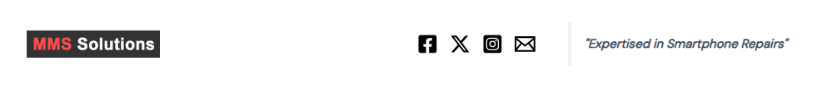
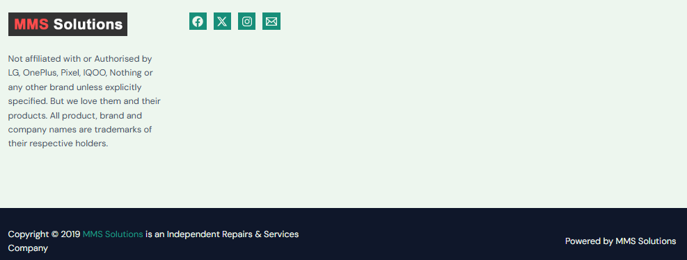
Header & Footer

Slide 38
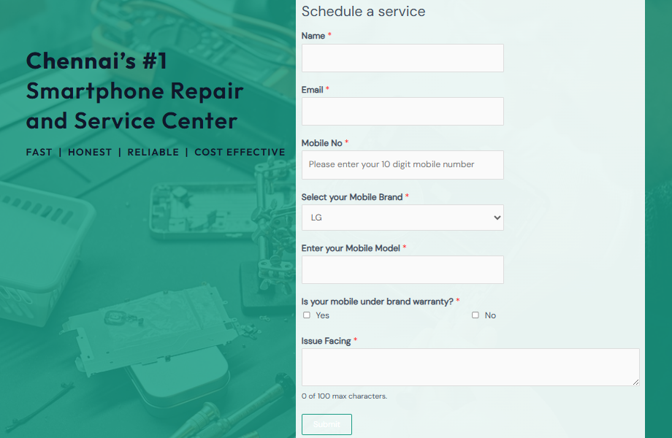
Lead-Generation Form

Slide 39
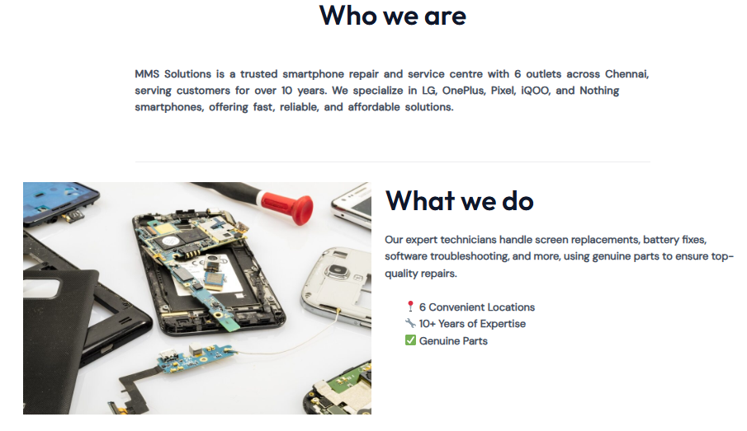
About

Slide 40
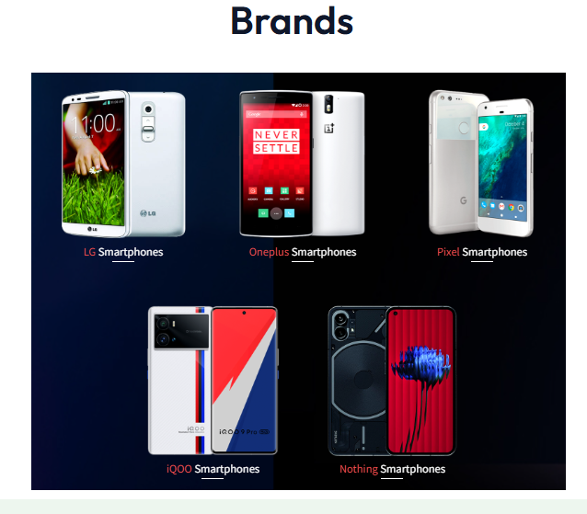
Brands

Slide 41
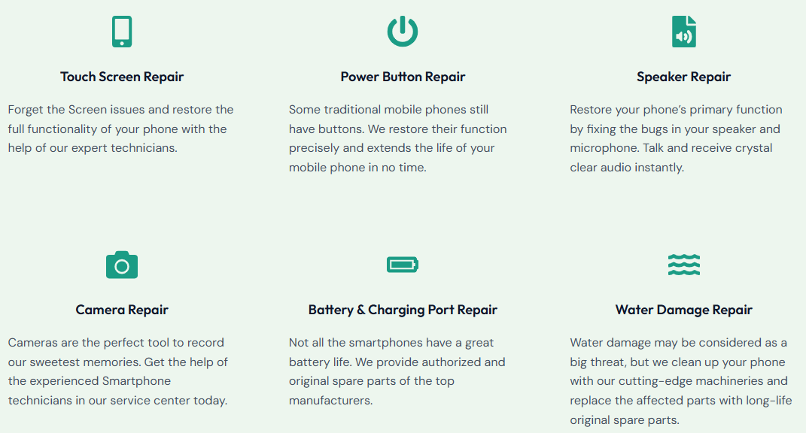
Services

Slide 42
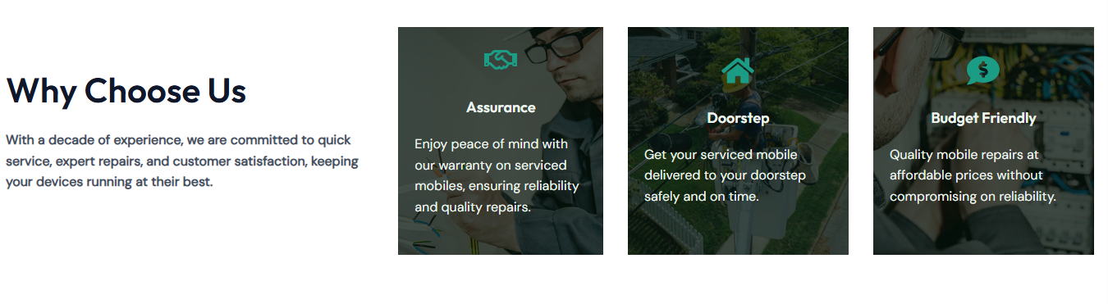
Strengths

Slide 43
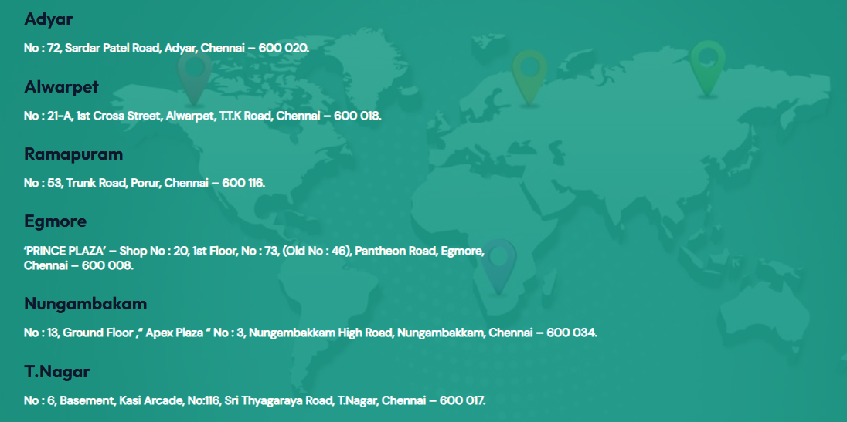
Outlets

Slide 44
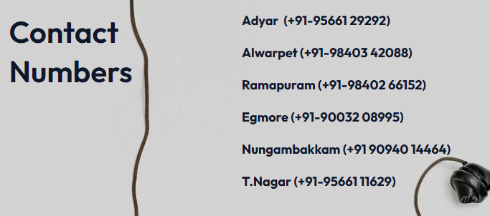
Contact Numbers for Outlets

Slide 45

THANK YOU
Thambidurai Sundaramoorthy
stdurai95@gmail.com

